Slide 1
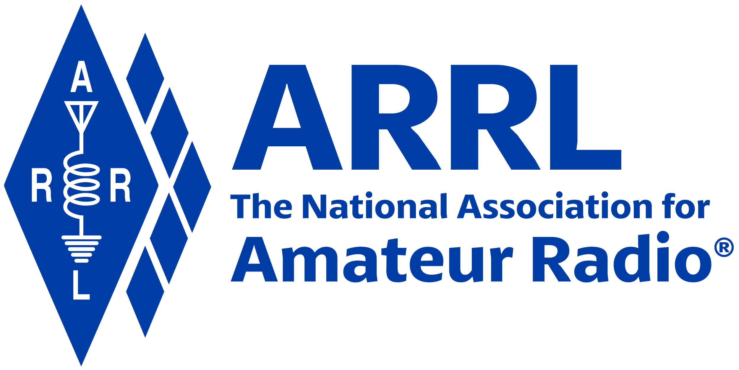
Amateur Radio Technician Exam Preparation Course

Slide 2
Amateur Radio Technician Exam Prep Course
Module 4
Propagation, Antennas, and Feed Lines
4.1 Propagation
4.2 Antenna and Radio Wave Basics
4.3 Feed Lines and SWR
4.4 Practical Antenna Systems

Slide 3
Propagation
Radio waves propagate in many ways depending on …
Frequency of the wave
Characteristics of the environment
We will discuss three basic ways:
Line of sight
Ground wave
Sky wave

Slide 4
Line of Sight
Radio energy can travel in a straight line from a transmitting antenna to a receiving antenna – called the direct path
There is some attenuation of the signal as the radio wave travels due to spreading out
This is the primary propagation mode for VHF and UHF signals
Radio waves can be reflected by any sudden change in the path they are traveling, such as a building, hill, or even weather-related changes in the atmosphere
Vegetation can also absorb VHF and UHF radio waves
Precipitation such as fog and rain can absorb microwave and UHF radio waves although it has little effect at HF and on the lower VHF Bands

Slide 5
Ground Wave
At lower HF frequencies radio waves can follow the Earth’s surface
These waves will travel beyond the range of line-of-sight
Range of a few hundred miles

Slide 6
Reflect, Refract, Diffract
Radio waves are reflected by any conductive surface
Ground, water, buildings
Refraction or bending occurs when waves encounter a medium having a different speed of light, such as water or an electrical feed line
By bending signals slightly back towards the ground, refraction counteracts the curvature of the Earth and allows signals to be received at distances beyond the visual horizon
Knife edge diffraction: Diffraction as waves travel past sharp edges of large objects

Slide 7
Multipath
Radio signals arriving at a receiver after taking different paths from the transmitter
Results in irregular fading, even when reception is generally good
Because “dead spots” from multipath are usually spaced about ½-wavelength apart, VHF or UHF signals from a station in motion can take on a rapid variation in strength known as mobile flutter or picket-fencing
Distortion caused by multipath can also cause VHF and UHF digital data signals to be received with a higher error rate, even though the signal may be strong

Slide 8
Tropospheric Propagation
Propagation at and above VHF frequencies are assisted by variations in the atmosphere
Variations such as weather fronts or temperature inversions create layers of air next to each other that have different characteristics
The layers form structures called ducts that can guide even microwave signals for long distances
Regularly used by amateurs to make VHF and UHF contacts that would otherwise be impossible by line-of-sight propagation (300 miles or more)

Slide 9
PRACTICE QUESTIONS

Slide 10
Why do VHF signal strengths sometimes vary greatly when the antenna is moved only a few feet?
The signal path encounters different concentrations of water vapor
VHF ionospheric propagation is very sensitive to path length
Multipath propagation cancels or reinforces signals
All these choices are correct
T3A01 C 4-1

Slide 11
What is the effect of vegetation on UHF and microwave signals?
Knife-edge diffraction
Absorption
Amplification
Polarization rotation
T3A02 B 4-1

Slide 12
What is the meaning of the term “picket fencing”?
Alternating transmissions during a net operation
Rapid flutter on mobile signals due to multipath propagation
A type of ground system used with vertical antennas
Local vs long-distance communications
T3A06 B 4-1

Slide 13
What weather condition might decrease range at microwave frequencies?
High winds
Low barometric pressure
Precipitation
Colder temperatures
T3A07 C 4-1

Slide 14
What is a likely cause of irregular fading of signals propagated by the ionosphere?
Frequency shift due to Faraday rotation
Interference from thunderstorms
Intermodulation distortion
Random combining of signals arriving via different paths
T3A08 D 4-1

Slide 15
What effect does multi-path propagation have on data transmissions?
Transmission rates must be increased by a factor equal to the number of separate paths observed
Transmission rates must be decreased by a factor equal to the number of separate paths observed
No significant changes will occur if the signals are transmitted using FM
Error rates are likely to increase
T3A10 D 4-1

Slide 16
What is the effect of fog and rain on signals in the 10 meter and 6 meter bands?
Absorption
There is little effect
Deflection
Range increase
T3A12 B 4-1

Slide 17
Which of the following effects may allow radio signals to travel beyond obstructions between the transmitting and receiving stations?
Knife-edge diffraction
Faraday rotation
Quantum tunneling
Doppler shift
T3C05 A 4-1

Slide 18
What type of propagation is responsible for allowing over-the-horizon VHF and UHF communications to ranges of approximately 300 miles on a regular basis?
Tropospheric ducting
D region refraction
F2 region refraction
Faraday rotation
T3C06 A 4-1

Slide 19
What causes tropospheric ducting?
Discharges of lightning during electrical storms
Sunspots and solar flares
Updrafts from hurricanes and tornadoes
Temperature inversions in the atmosphere
T3C08 D 4-2

Slide 20
Why is the radio horizon for VHF and UHF signals more distant than the visual horizon?
Radio signals move somewhat faster than the speed of light
Radio waves are not blocked by dust particles
The atmosphere refracts radio waves slightly
Radio waves are blocked by dust particles
T3C11 C 4-2

Slide 21
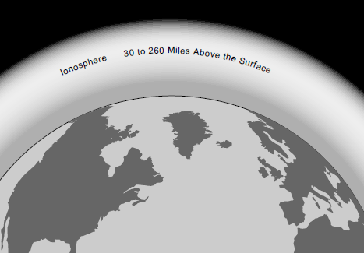
The Ionosphere
30 to 260 miles above Earth’s surface
Atmosphere thin enough for atoms to be ionized by solar ultraviolet radiation
Ions are electrically conductive
Because of varying density, the ionosphere forms layers with different amounts of ionization
Ionization varies with solar illumination (hourly) and intensity of solar radiation
Higher ionization refracts or bends radio waves more strongly

Slide 22
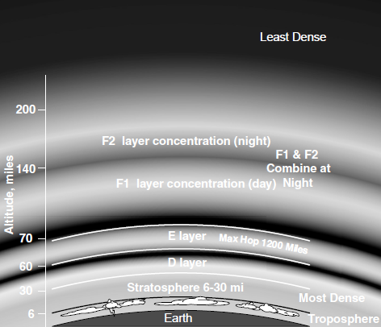
Ionosphere Layers
Layers: D, E, F1 and F2
Depending on whether it is night or day and on the intensity of solar radiation, these layers can refract (E, F1 and F2 layers) or absorb (D and E layers) radio waves
Each reflection from the ionosphere is called a hop (can go hundreds or thousands of miles)

Slide 23
Sunspot Cycle / Activity
The level of ionization depends on the intensity of radiation from the Sun
Radiation from the Sun varies with the number of sunspots on the Sun’s surface
High number of sunspots results in high levels of ionizing radiation emitted from the Sun
Sunspot activity follows an 11-year cycle
F layers can reflect 6 meter (50 MHz) signals at the sunspot cycle’s peak
Patches of the E layer can become sufficiently ionized to reflect VHF and UHF signals (called sporadic E) … most common during early summer and mid-winter months on 10, 6, and occasionally 2 meters

Slide 24
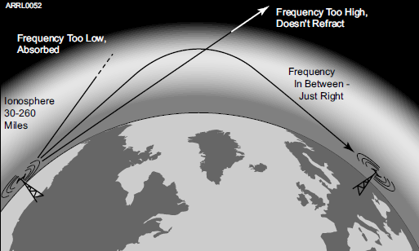
The Ionosphere – An RF Mirror
Ionosphere can refract radio waves back to Earth – acts like reflection
Most refraction occurs in the F layer
Reflection depends on frequency and angle of incidence
Too high a frequency or angle and the waves are lost to space
Fig 4.2: Signals in the right range of frequencies are refracted back toward the Earth and are received hundreds or thousands of miles away.

Slide 25
Ionosphere (cont.)
The highest frequency signal that can be reflected back to a point on the Earth between the transmitter and receiver is the maximum usable frequency
Sky-wave or skip propagation is responsible for most over-the-horizon propagation on HF and low VHF (10 and 6 meters) during peaks of the sunspot cycle
Skip is very rare on the 144 MHz and higher UHF bands
E region of the ionosphere is also home to meteor trails
Bouncing signals off of these ionized trails is called meteor scatter propagation
Best band for meteor scatter is 6 meters, and contacts can be made at distances up to 1200 to 1500 miles

Slide 26
PRACTICE QUESTIONS

Slide 27
Which region of the atmosphere can refract or bend HF and VHF radio waves?
The stratosphere
The troposphere
The ionosphere
The mesosphere
T3A11 C 4-3

Slide 28
Why are simplex UHF signals rarely heard beyond their radio horizon?
They are too weak to go very far
FCC regulations prohibit them from going more than 50 miles
UHF signals are usually not propagated by the ionosphere
UHF signals are absorbed by the ionospheric D region
T3C01 C 4-3

Slide 29
What is a characteristic of HF communication compared with communications on VHF and higher frequencies?
HF antennas are generally smaller
HF accommodates wider bandwidth signals
Long-distance ionospheric propagation is far more common on HF
There is less atmospheric interference (static) on HF
T3C02 C 4-3

Slide 30
What is a characteristic of VHF signals received via auroral backscatter?
They are often received from 10,000 miles or more
They are distorted and signal strength varies considerably
They occur only during winter nighttime hours
They are generally strongest when your antenna is aimed west
T3C03 B 4-3

Slide 31
Which of the following types of propagation is most commonly associated with occasional strong signals on the 10, 6, and 2 meter bands from beyond the radio horizon?
Backscatter
Sporadic E
D region absorption
Gray-line propagation
T3C04 B 4-3

Slide 32
What band is best suited for communicating via meteor scatter?
33 centimeters
6 meters
2 meters
70 centimeters
T3C07 B 4-3

Slide 33
What is generally the best time for long-distance 10 meter band propagation via the F region?
From dawn to shortly after sunset during periods of high sunspot activity
From shortly after sunset to dawn during periods of high sunspot activity
From dawn to shortly after sunset during periods of low sunspot activity
From shortly after sunset to dawn during periods of low sunspot activity
T3C09 A 4-3

Slide 34
Which of the following bands may provide long-distance communications via the ionosphere’s F region during the peak of the sunspot cycle?
6 and 10 meters
23 centimeters
70 centimeters and 1.25 meters
All these choices are correct
T3C10 A 4-3

Slide 35
Antenna and Radio Wave Basics
The antenna system …
Antenna: Transforms current into radio waves (transmit) and vice versa (receive)
Feed line: Connects your station to the antenna
Test and matching equipment: Allows you to monitor and optimize antenna system performance
For an antenna to do that job efficiently, its dimensions must be an appreciable fraction of the signal’s wavelength
The radio wave is an electromagnetic wave that contains both electric and magnetic energy or fields created by the RF current
The electric and magnetic fields are at right angles to each other and oscillate at the same frequency as the RF current in the antenna

Slide 36
Antenna Vocabulary
Element: The conducting part or parts of an antenna designed to radiate or receive radio waves
Driven element: The element supplied directly with power from the transmitter
Array: An antenna with more than one element
Parasitic element: Elements not connected directly to a feed line
Resonant: An antenna is resonant when its feed point impedance has zero reactance
Feed point: Where the transmitted energy enters the antenna
Radiation: NOT radioactivity! An antenna emitting electromagnetic waves.

Slide 37
Electromagnetic Waves
Radio waves are electromagnetic waves
Electric and magnetic fields at right angles to each other, oscillating at the wave’s frequency
Spread out into space from the antenna
Created by AC current
Wave and current have the same frequency

Slide 38
Wave Polarization
Refers to the orientation of the radio wave’s electric field
Vertical or horizontal – determined by elements
Can be circular if the orientation twists as the wave spreads through space
Combinations of polarization are called elliptical polarization (both vertical and horizontal antennas are effective for receiving and transmitting on the HF bands where skip propagation is common)
When the polarizations of transmit and receive antennas aren’t aligned the same, the received signal can be dramatically reduced (less current is created in the antenna)
Summary: Antenna and wave polarization must match for maximum reception

Slide 39
PRACTICE QUESTIONS

Slide 40
What happens when antennas at opposite ends of a VHF or UHF line of sight radio link are not using the same polarization?
The modulation sidebands might become inverted
Received signal strength is reduced
Signals have an echo effect
Nothing significant will happen
T3A04 B 4-5

Slide 41
Which of the following results from the fact that signals propagated by the ionosphere are elliptically polarized?
Digital modes are unusable
Either vertically or horizontally polarized antennas may be used for transmission or reception
FM voice is unusable
Both the transmitting and receiving antennas must be of the same polarization
T3A09 B 4-5

Slide 42
What is the relationship between the electric and magnetic fields of an electromagnetic wave?
They travel at different speeds
They are in parallel
They revolve in opposite directions
They are at right angles
T3B01 D 4-5

Slide 43
What property of a radio wave defines its polarization?
The orientation of the electric field
The orientation of the magnetic field
The ratio of the energy in the magnetic field to the energy in the electric field
The ratio of the velocity to the wavelength
T3B02 A 4-5

Slide 44
What are the two components of a radio wave?
Impedance and reactance
Voltage and current
Electric and magnetic fields
Ionizing and non-ionizing radiation
T3B03 C 4-5

Slide 45
Antenna (Some Vocabulary)
Gain: Apparent increase in power in a particular direction by focusing radiation in that direction. Measured in decibels (dB).
Isotropic: Equal radiation in all directions
Omnidirectional: No preferred horizontal direction
Directional: Antenna that focuses radiation in specific directions

Slide 46
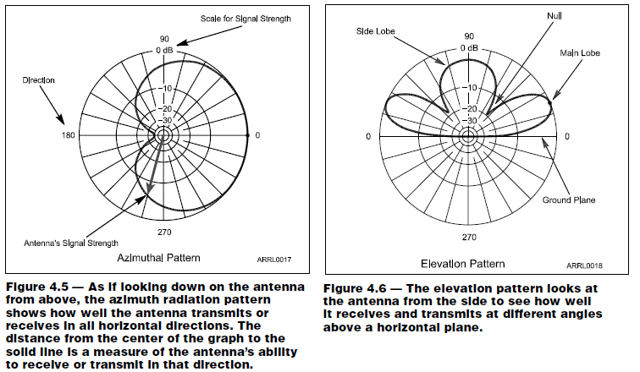
Antenna Radiation Patterns

Slide 47
Antenna Radiation Patterns (cont.)
(from previous screen)
Radiation patterns are a way of visualizing antenna performance
The further the line is from the center of the graph, the stronger the signal at that point
Graphs calibrated in dB
Most common type of radiation pattern is an azimuthal pattern that shows the antenna’s gain in horizontal directions around the antenna
An elevation pattern shows the strength of the radiated energy in vertical directions as if the antenna is viewed from the side

Slide 48
Radiation Pattern Vocabulary
Nulls: Directions of minimum gain
Lobes: Regions between nulls
Main lobe: Lobe with highest gain
Side lobe: Any lobe other than the main lobe
Forward gain: Gain in the direction assigned as forward
Azimuth pattern: Radiation pattern showing gain in all horizontal directions around the antenna
Elevation pattern: Radiation pattern showing gain at all vertical angles from the antenna
Often restricted to angles above horizontal
Front-to-back ratio: Ratio of forward gain to gain in the opposite direction
Front-to-side ratio: Ratio of forward gain to gain at right angles to the forward direction

Slide 49
The Decibel (dB*)
A ratio expressed as a power of 10 to make large numbers easier to work with
Decibel measures the ratio of two quantities as a power of 10
dB = 10 log (power ratio)
dB = 20 log (voltage ratio)
Positive values in dB indicate ratios > 1 and negative values of dB are for ratios < 1
Antenna gain is discussed in terms of dB
* Pronounced “dee-bee”

Slide 50
PRACTICE QUESTIONS

Slide 51
What is antenna gain?
The additional power that is added to the transmitter power
The additional power that is required in the antenna when transmitting on a higher frequency
The increase in signal strength in a specified direction compared to a reference antenna
The increase in impedance on receive or transmit compared to a reference antenna
T9A11 C 4-7

Slide 52
Which decibel value most closely represents a power increase from 5 watts to 10 watts?
2 dB
3 dB
5 dB
10 dB
T5B09 B 4-8

Slide 53
Which decibel value most closely represents a power decrease from 12 watts to 3 watts?
–1 dB
–3 dB
–6 dB
–9 dB
T5B10 C 4-8

Slide 54
Which decibel value represents a power increase from 20 watts to 200 watts?
10 dB
12 dB
18 dB
28 dB
T5B11 A 4-8

Slide 55
Feed Lines & SWR
The purpose of the feed line is to get RF power from your station to the antenna
Basic feed line types
Coaxial cable (coax)
Open-wire line (OWL) also called ladder line or window line
Power lost as heat in the feed line is called loss and it increases with frequency
Feed lines used at radio frequencies use special materials and construction methods to minimize power being dissipated as heat by feed line loss and to avoid signals leaking in or out

Slide 56
Feed Line Vocabulary
Center conductor: Central wire
Dielectric: Insulation surrounding center conductor
Shield: Braid or foil surrounding dielectric
Jacket: Protective outer plastic coating
Forward (reflected) power: RF power traveling toward (away from) a load such as an antenna

Slide 57
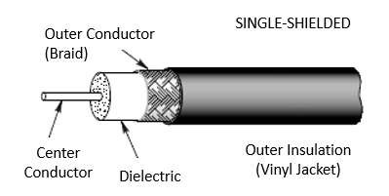
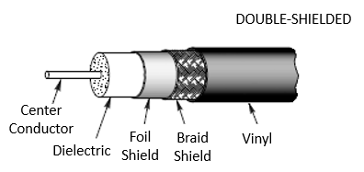
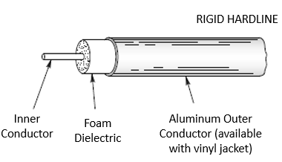
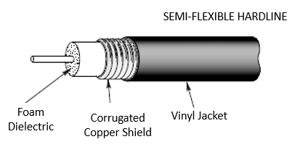
Coaxial Cable

Slide 58
Coaxial Cable (cont.)
Most common feed line
Easy to use
Carries the radio signal on the surface of the center conductor and the inside surface of the shield
Not affected by nearby materials
Has higher loss than open-wire line at most frequencies
Air-insulated hard line has lowest loss (but, limits the amount of bending)

Slide 59
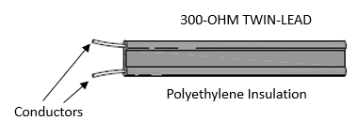
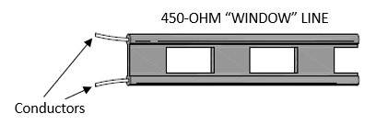
Open-Wire Line
Lighter and less expensive than coax
Lower loss than coax at most frequencies
More difficult to use since it is affected by nearby materials
Requires impedance matching equipment to use with most transceivers
Open-wire feed lines cannot be buried or installed in metal conduits and must be kept clear of nearby conducting surfaces

Slide 60
Characteristic Impedance
The impedance presented to a wave traveling through a feed line
Given in ohms (Ω), symbolized as ZØ
Depends on how the feed line is constructed and what materials are used
Coax: 50 and 75 Ω
OWL: 300, 450, and 600 Ω
Most coaxial cable used in ham radio has a characteristic impedance of 50 Ω

Slide 61
Standing Wave Ratio (SWR)
If the antenna feed point and feed line impedances are not identical, some RF power is reflected back toward the transmitter
Called a mismatch
Forward and reflected waves create a pattern of standing waves of voltage and current in the line
SWR is the ratio of standing wave max to min
Measured with an SWR meter or SWR bridge

Slide 62
SWR (cont.)
Reflected power is re-reflected at the transmitter and bounces back and forth
Some RF power is lost as heat on each trip back and forth through the feed line
All RF power is eventually lost as heat or transferred to the antenna or load
High SWR means more reflections and more loss of RF power (less transferred to the antenna or load)
SWR equals the ratio of feed point (or load) and feed line impedance, whichever is greater than 1 (SWR always greater than 1:1)
What is an acceptable SWR?
1:1 SWR is perfect – no power reflected
Up to 2:1 SWR is normal
Modern radios lower transmitter output power for protection when SWR is above 2:1

Slide 63
SWR (cont.)
SWR above 3:1 is considered high in most cases
Erratic SWR readings may indicate a faulty feed line, faulty feed line connectors, or a faulty antenna
High SWR can be corrected by
Tuning or adjusting the antenna
With impedance matching equipment at the transmitter
Called an antenna tuner or transmatch
Does not change SWR in the feed line

Slide 64
PRACTICE QUESTIONS

Slide 65
What happens to power lost in a feed line?
It increases the SWR
It is radiated as harmonics
It is converted into heat
It distorts the signal
T7C07 C 4-9

Slide 66
What is the most common impedance of coaxial cables used in amateur radio?
8 ohms
50 ohms
600 ohms
12 ohms
T9B02 B 4-9

Slide 67
Why is coaxial cable the most common feed line for amateur radio antenna systems?
It is easy to use and requires few special installation considerations
It has less loss than any other type of feed line
It can handle more power than any other type of feed line
It is less expensive than any other type of feed line
T9B03 A 4-9

Slide 68
What happens as the frequency of a signal in coaxial cable is increased?
The characteristic impedance decreases
The loss decreases
The characteristic impedance increases
The loss increases
T9B05 D 4-9

Slide 69
Which of the following types of feed line has the lowest loss at VHF and UHF?
50-ohm flexible coax
Multi-conductor unbalanced cable
Air-insulated hardline
75-ohm flexible coax
T9B11 C 4-17

Slide 70
Which of the following should be considered when selecting an accessory SWR meter?
The frequency and power level at which the measurements will be made
The distance that the meter will be located from the antenna
The types of modulation being used at the station
All these choices are correct
T4A02 A 4-10

Slide 71
What reading on an SWR meter indicates a perfect impedance match between the antenna and the feed line?
50:50
Zero
1:1
Full Scale
T7C04 C 4-10

Slide 72
Why do most solid-state transmitters reduce output power as SWR increases beyond a certain level?
To protect the output amplifier transistors
To comply with FCC rules on spectral purity
Because power supplies cannot supply enough current at high SWR
To lower the SWR on the transmission line
T7C05 A 4-10

Slide 73
What does an SWR reading of 4:1 indicate?
Loss of -4 dB
Good impedance match
Gain of +4 dB
Impedance mismatch
T7C06 D 4-10

Slide 74
What is a benefit of low SWR?
Reduced television interference
Reduced signal loss
Less antenna wear
All these choices are correct
T9B01 B 4-10

Slide 75
What can cause erratic changes in SWR?
Local thunderstorm
Loose connection in the antenna or feed line
Over-modulation
Overload from a strong local station
T9B09 B 4-10

Slide 76
What is standing wave ratio (SWR)?
A measure of how well a load is matched to a transmission line
The ratio of amplifier power output to input
The transmitter efficiency ratio
An indication of the quality of your station’s ground connection
T9B12 A 4-9

Slide 77
Practical Antenna Systems: Dipoles
Simplest type of antenna
Dipole means “two electrical parts”
Made from a straight conductor of wire one-half wavelength (1⁄2 λ) long with a feed point somewhere along the antenna
Most are oriented horizontally, particularly on the lower frequency bands, and radiate a horizontally polarized signal
Can also be installed vertically, sloping or even drooping from a single support in the middle (inverted-V)
The radiation pattern isolated in space looks like a donut

Slide 78
Ground Plane Antennas
Most common type is one-quarter wavelength long (1⁄4 λ) with the feed point at the base
Acts like one-half of a dipole with the missing portion made up by the electrical mirror formed by the ground plane
Made from sheet metal or a screen of wires called radials that extend out from the base
Extended length of a 5⁄8-λ ground-plane focuses more energy toward the horizon (better range)
To reduce the physical size of the antenna, it is often constructed with some of the radiating conductor wound into a coil or a separate inductor inserted in the antenna … called is called inductive loading

Slide 79
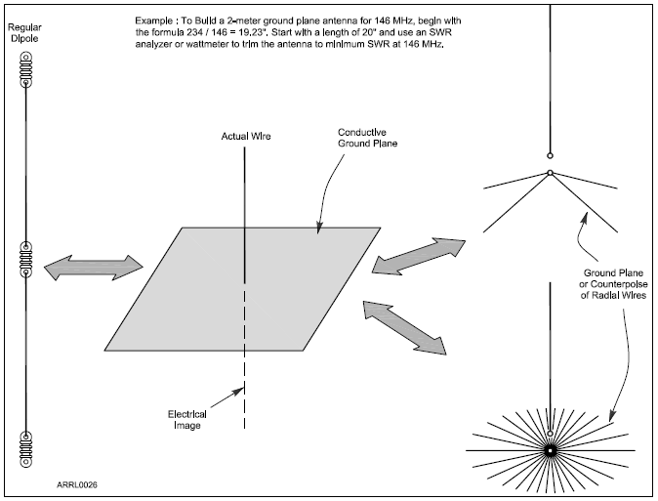
Figure 4.10 — A ground-plane makes up an electrical mirror that creates an image of the missing half of a ground-plane antenna. The result is an antenna that acts very much like a dipole. The ground plane can be made up of a screen of wires (often used at HF) or a metal surface at VHF and UHF. For VHF and UHF antennas mounted on masts, a counterpoise of a few wires serves the same purpose.

Slide 80
Antennas for Handheld Radios
The flexible antenna used with most handheld radios is called a rubber duck (ground-plane antenna shortened by coiling the conductor inside a plastic coating)
Doesn’t transmit or receive as well as a full-sized ground-plane antenna
For best performance, hold the transceiver so that the antenna is vertical
Not very effective inside vehicles … up to 20 time less effective than an external mobile antenna
Easy to connect handhelds to full-sized antennas … uses standard RF connectors … a 5-watt handheld can easily reach 10 miles with a “good” antenna

Slide 81
Calculating Antenna Length (dipole)
To calculate length of a resonant dipole 1⁄2-λ long …
Length (in feet) = 468 / frequency (in MHz) … or
Length = 468 / f
Example: At 50.1 MHz (in the 6 meter band), dipole length is
calculated as 468 / 50.1 = 9.33 feet = 112 inches long
NOTE: The value of the constant used in the formula accounts for effects that cause an antenna to act like it is a little longer electrically than it is physically. The actual resonant length is affected by height above ground, its electrical properties, and nearby conductive objects. So …
Make the dipole a few percent longer at first (use 490 instead of 468), then use an SWR meter or antenna analyzer to determine the resonant frequency. Assuming the resonant frequency is too low because the dipole is too long, shorten it until the dipole is resonant at the desired frequency.

Slide 82
Calculating Ground Plane Length
The length of a ground-plane antenna is half that of a dipole and is often estimated as: length (in feet) = 234 / frequency (in MHz)
Example: At 146 MHz, a λ/4 ground-plane is 234 / 146 = 1.6 feet = 19 ¼ inches long
Length adjustments also apply (similar to previous note about dipoles)

Slide 83
Directional Antennas
Simple dipoles, ground-planes, and loops work well, but they have little gain (radiation patterns don’t have strongly preferred directions)
Use a directional beam antenna get the best reception in one direction
On VHF and UHF, if a direct signal path is blocked, a beam antenna can be used to aim the signal at a reflecting surface to bypass the obstruction
Most widely used type of beam antennas are Yagis
Yagi beam antennas have much more gain than omni-directionals in their preferred direction

Slide 84
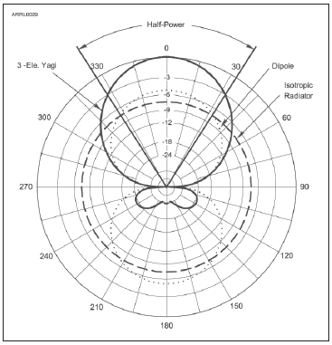
Yagi
Figure 4.13 — The radiation pattern of a typical, three-element Yagi antenna with a driven element, reflector, and director shows that most of the antenna’s energy is focused in one
direction along the boom of the antenna (along the 0-180 axis of the graph.) Smaller amounts are radiated toward the side and back. This
antenna also rejects noise and interference from the side and back. The round pattern of the isotropic antenna and the figure-eight
pattern of a dipole are included for reference.

Slide 85
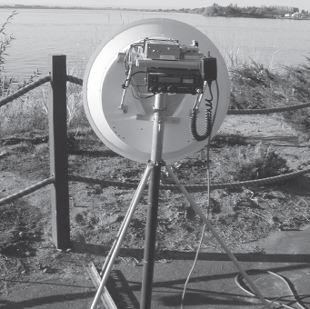
Yagis (cont.)
Horizontally polarized Yagis are usually used for long-distance communications (results in lower ground losses when the wave reflects from or travels along the ground)
As frequency increases and the size of Yagi elements become smaller, it becomes more difficult to construct practical antennas
Above 1GHz, dish antennas become practical
Figure 4.14 — N7CFO’s dish antenna operates on 10 GHz and is portable enough to be taken on contest outings.
Figure 4.14 — N7CFO’s dish antenna operates on 10 GHz and is portable enough to be taken on contest outings.

Slide 86
PRACTICE QUESTIONS

Slide 87
Which of the following describes a type of antenna loading?
Electrically lengthening by inserting inductors in radiating elements
Inserting a resistor in the radiating portion of the antenna to make it resonant
Installing a spring in the base of a mobile vertical antenna to make it more flexible
Strengthening the radiating elements of a beam antenna to better resist wind damage
T9A02 A 4-12

Slide 88
Which of the following describes a simple dipole oriented parallel to Earth’s surface?
A ground-wave antenna
A horizontally polarized antenna
A travelling-wave antenna
A vertically polarized antenna
T9A03 B 4-12

Slide 89
What is a disadvantage of the short, flexible antenna supplied with most handheld radio transceivers, compared to a full-sized quarter-wave antenna?
It has low efficiency
It transmits only circularly polarized signals
It is mechanically fragile
All these choices are correct
T9A04 A 4-12

Slide 90
Which of the following increases the resonant frequency of a dipole antenna?
Lengthening it
Inserting coils in series with radiating wires
Shortening it
Adding capacitive loading to the ends of the radiating wires
T9A05 C 4-12

Slide 91
What is a disadvantage of using a handheld VHF transceiver with a flexible antenna inside a vehicle?
Signal strength is reduced due to the shielding effect of the vehicle
The bandwidth of the antenna will decrease, increasing SWR
The SWR might decrease, decreasing the signal strength
All these choices are correct
T9A07 A 4-12

Slide 92
What is the approximate length, in inches, of a quarter-wavelength vertical antenna for 146 MHz?
112
50
19
12
T9A08 C 4-12

Slide 93
What is the approximate length, in inches, of a half-wavelength 6 meter dipole antenna?
6
50
112
236
T9A09 C 4-12

Slide 94
In which direction does a half-wave dipole antenna radiate the strongest signal?
Equally in all directions
Off the ends of the antenna
In the direction of the feed line
Broadside to the antenna
T9A10 D 4-12

Slide 95
What is an advantage of a 5/8 wavelength whip antenna for VHF or UHF mobile service?
It has more gain than a 1/4-wavelength antenna
It radiates at a very high angle
It eliminates distortion caused by reflected signals
It has 10 times the power gain of a 1/4 wavelength whip
T9A12 A 4-12

Slide 96
What antenna polarization is normally used for long-distance CW and SSB contacts on the VHF and UHF bands?
Right-hand circular
Left-hand circular
Horizontal
Vertical
T3A03 C 4-15

Slide 97
When using a directional antenna, how might your station be able to communicate with a distant repeater if buildings or obstructions are blocking the direct line of sight path?
Change from vertical to horizontal polarization
Try to find a path that reflects signals to the repeater
Try the long path
Increase the antenna SWR
T3A05 B 4-15

Slide 98
What is a beam antenna?
An antenna built from aluminum I-beams
An omnidirectional antenna invented by Clarence Beam
An antenna that concentrates signals in one direction
An antenna that reverses the phase of received signals
T9A01 C 4-15

Slide 99
Which of the following types of antenna offers the greatest gain?
5/8 wave vertical
Isotropic
J pole
Yagi
T9A06 D 4-15

Slide 100
Practical Feed Lines & Associated Equipment
Table 4.1: Common Types of Coaxial Cable
Loss in dB
TYPE | IMPEDANCE | Loss Per 100’ @ 30 MHz | Loss Per 100’ @ 150 MHz
RG-6 | 75 | 1.4 | 33
RG-8 | 50 | 1.1 | 2.5
RG-8X | 50 | 2.0 | 4.5
RG-58 | 50 | 2.5 | 5.6
RG-59 | 75 | 1.8 | 4.1
RG-174 | 50 | 4.6 | 10.3
RG-213 | 50 | 1.1 | 2.5
LMR-400 | 50 | 0.7 | 1.5
Online calculator: www.timesmicrowave.com/calculator

Slide 101
Coaxial Cable (called COAX)
See Table 4.1
Performance of coaxial cable depends on the integrity of its outer jacket
Moisture contamination is the most common cause of coax failure
Prolonged exposure to the ultraviolet (UV) in sunlight will also cause the plastic in the jacket to degrade … then cracks … then moisture
Some coax jackets use a pigment to absorb & block UV
Coax should not be bent sharply (can short center conductor to outer braid)

Slide 102
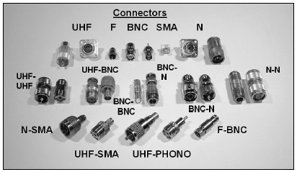
Coaxial Feed Line Connectors
Type of connector to use depends on signal frequency
UHF* series of connectors (PL-259 plugs and SO-239 receptacles) are the most widely-used for HF equipment
Above 400 MHz, the Type N connectors are used
Water in coaxial cable degrades the effectiveness of the braided shield (increases losses)
In low-loss air-core or “open-cell foam” coax, special techniques are required to prevent water absorption
Figure 4.15 — The photo shows a variety of common coaxial connectors that hams use. The larger connectors are used for higher power transmitters and antennas. The most common are the UHF and N styles. Special adapters are used to make connections between cables and equipment that have different styles of connectors.
* UHF in this case is NOT Ultra High Frequency!

Slide 103
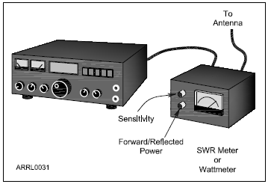
SWR Meters and Wattmeters
SWR Meters measure SWR by placing them in series with the feed line, usually right at the output of the radio
Many radios include a built-in SWR meter
Alternatively, a directional wattmeter can be used to measure SWR
Measure power flowing toward the antenna and power reflected from the antenna by rotating a sensing element or turning a switch
Figure 4.16 — The SWR meter measures power flowing toward the antenna (forward) and toward the transmitter (reflected or reverse).

Slide 104
Antenna Tuners
Impedance matchers or transmatches or antenna tuners are used If the SWR at the end of the feed line is too high for the radio to operate properly
Connected at the output of the transmitter
Adjusted until the SWR measured at the transmitter output is acceptably close to 1:1 (antenna system’s impedance has been matched to that of the transmitter output)
Most tuners combine the functions of impedance matcher, directional wattmeter and antenna switch
Automatic tuners sense when SWR is high and make the necessary adjustments

Slide 105
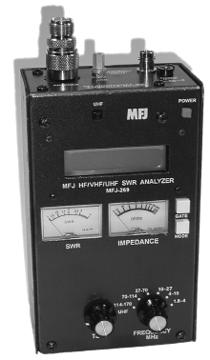
Antenna Analyzers
Used to measure an antenna system without using a transmitter whose signal might cause interference
Figure 4.18 — The popular MFJ series of antenna analyzers are used to adjust and troubleshoot antenna systems. The instrument contains a low-power signal source with an adjustable frequency and an SWR meter. The LCD display shows the operating frequency and information about the antenna impedance. The meters show SWR and feed point impedance.

Slide 106
PRACTICE QUESTIONS

Slide 107
Which of the following causes failure of coaxial cables?
Moisture contamination
Solder flux contamination
Rapid fluctuation in transmitter output power
Operation at 100% duty cycle for an extended period
T7C09 A 4-17

Slide 108
Why should the outer jacket of coaxial cable be resistant to ultraviolet light?
Ultraviolet resistant jackets prevent harmonic radiation
Ultraviolet light can increase losses in the cable’s jacket
Ultraviolet and RF signals can mix, causing interference
Ultraviolet light can damage the jacket and allow water to enter the cable
T7C10 D 4-17

Slide 109
What is a disadvantage of air core coaxial cable when compared to foam or solid dielectric types?
It has more loss per foot
It cannot be used for VHF or UHF antennas
It requires special techniques to prevent moisture in the cable
It cannot be used at below freezing temperatures
T7C11 C 4-17

Slide 110
Which of the following types of solder should not be used for radio and electronic applications?
Acid-core solder
Lead-tin solder
Rosin-core solder
Tin-copper solder
T7D08 A 4-17

Slide 111
What is the characteristic appearance of a cold tin-lead solder joint?
Dark black spots
A bright or shiny surface
A rough or lumpy surface
Excessive solder
T7D09 C 4-17

Slide 112
Which of the following RF connector types is most suitable for frequencies above 400 MHz?
UHF (PL-259/SO-239)
Type N
RS-213
DB-25
T9B06 B 4-17

Slide 113
Which of the following is true of PL-259 type coax connectors?
They are preferred for microwave operation
They are watertight
They are commonly used at HF and VHF frequencies
They are a bayonet-type connector
T9B07 C 4-17

Slide 114
Which of the following is a source of loss in coaxial feed line?
Water intrusion into coaxial connectors
High SWR
Multiple connectors in the line
All these choices are correct
T9B08 D 4-17

Slide 115
What is the electrical difference between RG-58 and RG-213 coaxial cable?
There is no significant difference between the two types
RG-58 cable has two shields
RG-213 cable has less loss at a given frequency
RG-58 cable can handle higher power levels
T9B10 C 4-17

Slide 116
Where should an RF power meter be installed?
In the feed line, between the transmitter and antenna
At the power supply output
In parallel with the push-to-talk line and the antenna
In the power supply cable, as close as possible to the radio
T4A05 A 4-18

Slide 117
Which of the following is used to determine if an antenna is resonant at the desired operating frequency?
A VTVM
An antenna analyzer
A Q meter
A frequency counter
T7C02 B 4-18

Slide 118
Which instrument can be used to determine SWR?
Voltmeter
Ohmmeter
Iambic pentameter
Directional wattmeter
T7C08 D 4-18

Slide 119
What is the major function of an antenna tuner (antenna coupler)?
It matches the antenna system impedance to the transceiver’s output impedance
It helps a receiver automatically tune in weak stations
It allows an antenna to be used on both transmit and receive
It automatically selects the proper antenna for the frequency band being used
T9B04 A 4-18

Slide 120
END OF MODULE 4

